Slide 1
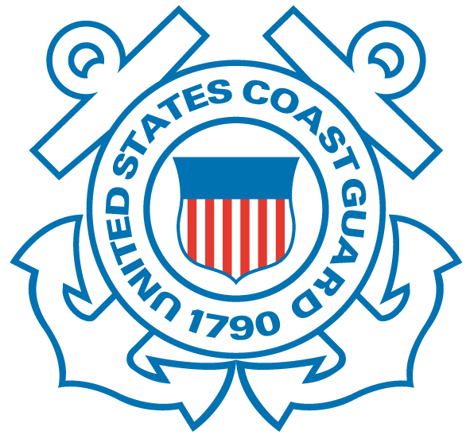
U.S. Coast Guard LCDR Krissy Marlin Sector Lower MS River
Containers by Barge
& associated regulated facilities
Notes:
NCIP = National Container Inspection Program

Slide 2
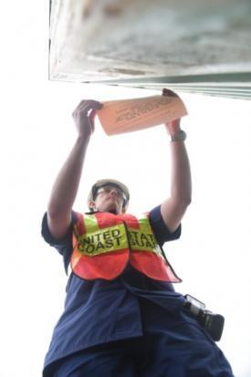
What We Do
Ensure safety and security of cargo on facilities that handle containerized hazmat
Ensure containers are properly labeled and segregated IAW 49 CFR or IMDG
Ensure integrity of shipping containers containing hazmat
Examine container yards for undeclared hazmat
Examine barge’s dangerous cargo manifest & shipping papers
Facilitate safe transit

Slide 3
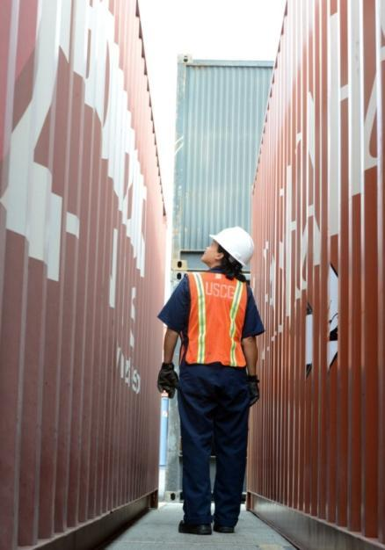
Coast Guard Responsibility
Protect:
Maritime community
American public
Environment
Standardize enforcement
DOT Enforcement Officers
IMO signatory Port State
Facilitate commerce
Educate & help shippers & carriers
Notes:
PWSA
Coast Guard COTP Authority
Executive Order No. 10173 – Truman - October 18, 1950
Super 6
ISCS
Codified in 49 CFR
In 1972 the IMO and United
Nations adopted CSC 1972
Defined freight containers
Implemented standards for
containers used internationally
Federal Hazardous Materials Transportation Act
49 USC §§ 5101-5127
49 CFR 171-180
Delegation authorizes the Coast Guard to:
“carry out the functions relating to investigations, records, inspections, penalties, and specific relief, with particular emphasis on the transportation or shipment of hazardous materials by water”
Federal Hazardous Materials Transportation Law
Secretary of Transportation tasked
“...to provide adequate protection against the risks to life and property inherent in the transportation of hazardous material in commerce by improving the regulatory and enforcement authority…”
Responsibility Delegated
Pipeline and Hazardous Material Safety Administration
Federal Highway Administration
Federal Aviation Administration
Federal Railroad Administration
Coast Guard
Federal Hazardous Materials Safety Act
Ports & Waterways Safety Act
Executive Order 10173
International Safe Container Act
MARPOL / SOLAS

Slide 4
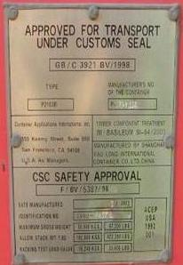
Authority & Jurisdiction
Federal Hazardous Materials Transportation Law (FHMTL)
International Safe Container Act (ISCA)
International Maritime Organization’s (IMO) Safety Of Life At Sea (SOLAS)
Convention for the Prevention of Pollution from Ships (MARPOL)
Port and Waterways Safety Act (PWSA)
Maritime Transportation Security Act (MTSA)
Notes:
The basic statute regulating hazardous materials transportation in the United States. Coast Guard has authority to enforce regulations pertaining to hazardous materials carried by vessel.
“to insure the safety of vessels and waterfront facilities, and the protection of the navigable waters and resources”
33 CFR 6 inspect and search at any time any vessel, waterfront facility, or security zone, or any person, article, or thing therein within the jurisdiction of the United States, may place guards upon such vessel, waterfront facility, or security zone
Hazardous Materials / Dangerous Goods:
Federal Hazardous Materials Transportation Law (FHMTL)
International Convention for the Safety of Life at Sea (SOLAS)
International Convention for the Prevention of Pollution for Ships (MARPOL), Annex III
Container Structural Standards:
International Safe Container Act (ISCA)
International Convention for Safe Containers (CSC) , 1972
Facility Access / Operational Control:
Ports and Waterways Safety Act (PWSA)
33 Code of Federal Regulations (CFR) 6
MTSA: 33 CFR 101-105

Slide 5
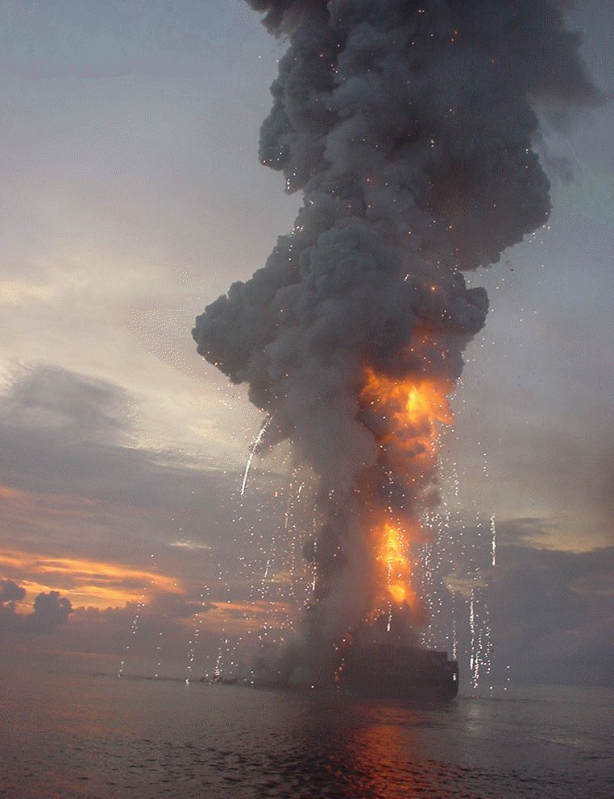
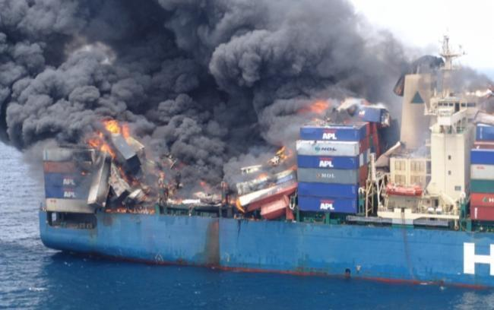
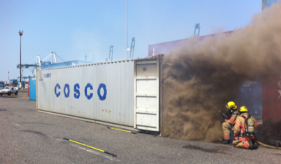
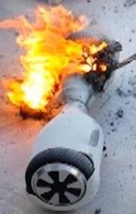
Risks of shipping HAZMAT by water
Notes:
- Talk about 1992 Santa Clara; the different roles & responsibilities Shipper, offerer, carrier, forwarder, consolidator, facility
We remain alert. 2. We are a layered support mechanism
2015 voyage off of Vietnam, the contents of a China packed-container had a fire starting from cargo ID’d as water pipe-charcoal. The crew extinguished the fire before it spread. A 3rd party investigation showed that self-heating of the charcoal tablets was the fire’s cause.
The container should have been declared as dangerous cargo by the shipper, but was not, thus the vessel stowed the container in a higher risk location.
This is common due to either ignorance of the hazmat or out of direct reason to avoid higher costs or skirt cargo rules.This is why our NCIP calls for 50% of our inspections to target containers manifested as general cargo, to verify undeclared HAZMAT is not being shipped through our ports.

Slide 6
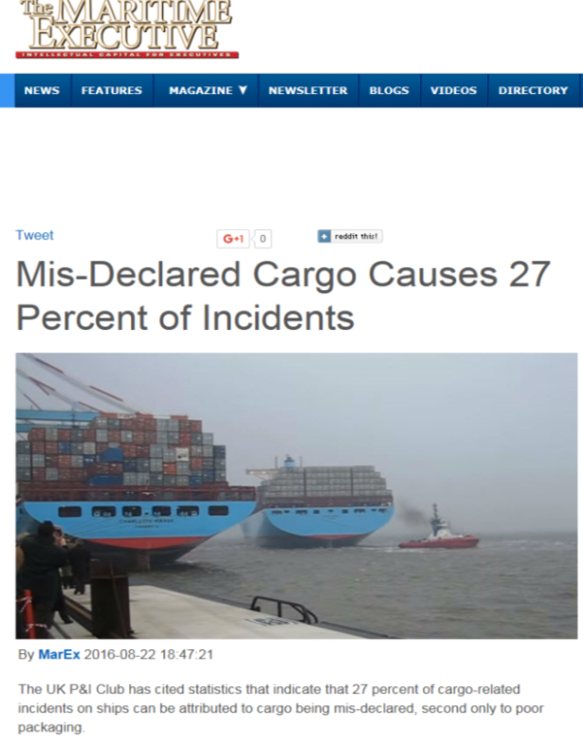
Why is this important?
August 2016 article: 27% of incidents were due to mis-declared cargo.
DOT reports: $5 Trillion US Hazmat trade (2013).
It is estimated that 10% of all containers moving have dangerous goods.
Notes:
It has been estimated that container ships lose over 10,000 containers at sea each year. DOT requires shippers to notify the USCG National Response Center w/in 12 hours of a hazardous material incident occurring. No international reporting requirement for general cargo or hazardous material container losses.
In 2006 the vessel Hyundai Fortune caught fire causing a estimated $8-9 million in damages. 500 containers were damaged. Most experts agree it was most likely caused by undeclared dangerous cargo.
Date21-mar-2006
Gulf of Aden, Yemen
Explosion (source unknown) caused fire and all bays behind the superstructure and the superstructure has been completely destroyed by the fire
The Sub-Committee noted documents CCC 2/10 (Sweden), CCC 2/10/1 (Belgium), CCC 2/10/2 (United States) and CCC 2/10/3 (Republic of Korea) reporting the results of container inspection programmes; and document CCC 2/INF.25 (Secretariat) containing the consolidated results. The Sub-Committee was informed that, among 54,195 CTUs inspected, 4,441 were found with deficiencies, meaning that 8.19% of the CTUs inspected had deficiencies. Total deficiencies were 5,223. As to types of deficiencies, placarding and marking account for 60%, followed by securing/stowage inside the unit (16%) and documentation (13%).
The UK P&I Club has cited statistics that indicate that 27 percent of cargo-related incidents on ships can be attributed to cargo being mis-declared, second only to poor packaging.
All dangerous goods must be carried in accordance with the provisions of the International Maritime Dangerous Goods (IMDG) Code, which is a set of globally accepted rules that enables packaged dangerous goods to be carried safely by sea. “As around 10 percent of all container cargoes constitute dangerous goods, virtually all container ship services fall within the scope of the Code,” says Risk Assessor David Nichol.
“It is imperative for the safety of the ship and crew that all necessary steps are taken to handle and stow dangerous goods in such a way that reduces the risk of an emergency incident and that, in the event of fire, the crew have the information they need to respond quickly with the appropriate fire-fighting measures. To enable this, a ship’s master must be provided with a correct, universally recognized description of the goods and the potential hazards they may present.”
The following factors contribute, either individually or in combination to cause incidents: • Mis-declaration or non-declaration by shippers • Quality and selection of packaging • Provision and accuracy of documentation and labelling • Professionalism of the container packing process • Human factors – regional, cultural and company attitudes to good practice and compliance • Unchecked irregularities in the product production process • Mis-handling or dropping containers
Taking one current issue, calcium hypochlorite is an oxidizing agent and is designated a Class 5.1 oxidizer in the IMDG Code. However, it is unstable and undergoes exothermic decomposition at elevated temperatures which can result in serious fires and explosions. There have been instances where calcium hypochlorite has been mis-declared as calcium chloride and other names encountered have included BK Powder, bleaching powder, CCH, disinfectant, Hy-chlor, chloride of lime or chlorinated lime.
“It is a requirement of the IMDG Code that cargoes are declared by their ‘Proper Shipping Name’ to combat issues of mis-declaration. Calcium hypochlorite is a Proper Shipping Name and as such should only be carried under that name with the appropriate UN number,” says Nichol.
“The International Group of P&I Clubs and the shipping line members of the Cargo Incident Notification System (CINS) have recently produced a new set of guidelines for the carriage of calcium hypochlorite in containers. It is hoped that these new guidelines will be seen as providing a clearer and more logical step-by- step guidance from issues surrounding cargo hazards, categorization under the IMDG Code, container selection, container packing and stowage on board ship.”
Between 1997 and 1999, there were six major incidents on container ships involving calcium hypochlorite in various forms, including the Contship France, Maersk Mombasa, Sea Express, DG Harmony, Aconcagua and CMA Djakarta. In 2012, the container ship MSC Flaminia suffered an explosion in a cargo hold, and a similar fire occurred in 2006 on the Hyundai Fortune.
Maersk Line recently announced a ban on carrying calcium hypochlorite as a containerized cargo. In July 2010, on Charlotte Maersk a calcium hypochlorite shipment caught fire en route from Malaysia to Oman. The crew of 25 received a special IMO Bravery Award for their eminent and brave extinction of the fast developing fire with flames of a height of up to 15 meters.

Slide 7
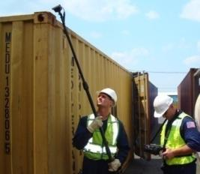
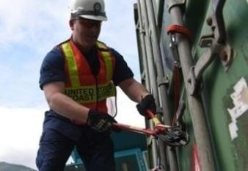
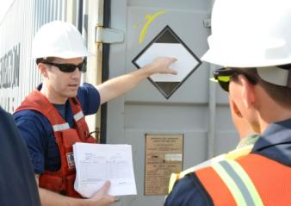
What Success Looks Like
Layered safety/security role
Targeting - Facilities & equal in/outbound vessels - MASFOs - 50% declared HAZMAT & 50% General Cargo (for undeclared)
Consistent Enforcement
End state: Safe Maritime Transportation System
Notes:
- MASFOs: Historical; important; surge enforcement activities involving multiple agencies w/varying jurisdictions, authorities and resources; corner stone for good working relationships/synergy between port agencies.
- Looking for the needle in the haystack…for undeclared.
It has been estimated that container ships lose over 10K containers at sea each year.
In 2006 the vessel Hyundai Fortune caught fire causing a estimated $8-9 million in damages. 500 containers were damaged. Most experts agree it was most likely caused by undeclared dangerous cargo.
Protect the public; protect vessels & crews; standardizing HAZMAT enforcement; eliminated needless delays; educate shippers; work with other DOT agencies.

Slide 8
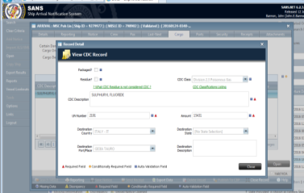
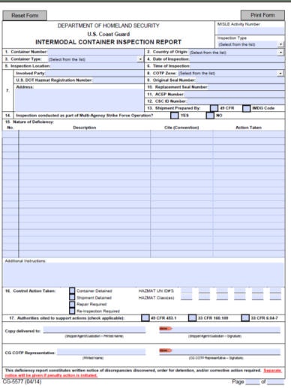
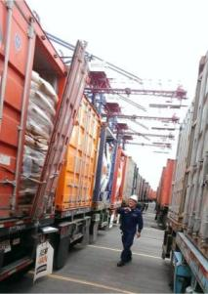
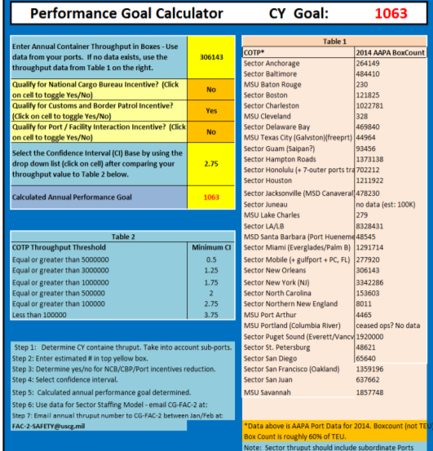
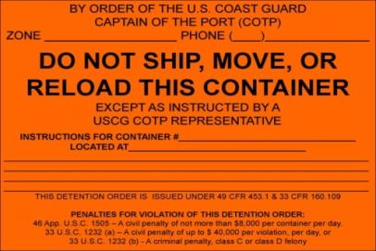
2. Target containers weekly
Set annual goals
3. Inspection
4. MISLE entry
5. Enforcement & Education
Notes:
Detention is primary enforcement tool used by CG Inspectors.
Note: we received 300 booklets (50 per booklet) 5577s to distribute.
Don’t have to use 5577 if no discrepancies.
MISLE work isn’t consistent.
HAZMAT takes longer.
Need to have a form to give for doing an inspection; to put in the container?
Port state control – 49 CFR 176…but this is different.

Slide 9
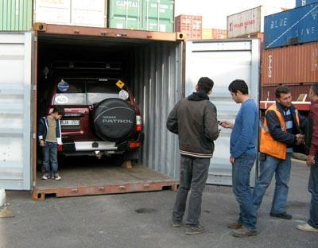
Shipper’s Responsibilities
6 Primary
Responsibilities
Classify
Communicate
Package
Stow
Segregate
Documents

Slide 10
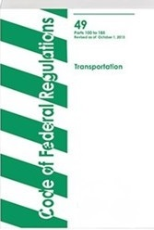
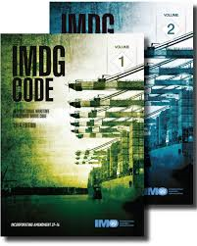
Vessel Shipment Regulations
Domestic
49 CFR Subchapter C (Vessel Specific §176) “hazardous materials”
International
International Maritime “Dangerous Goods” (IMDG) Code and 49 CFR 171.22-25
Notes:
SOLAS requires all shipments on an international voyage be shipped using IMDG. If that product is shipped into the United States or is to be transported in the United States, it still must meet 49 CFR 171.22-25.
49 CFR 171.22
DOT allows the use of IMDG within the U.S, if a portion of transit is by sea.
49 CFR establishes additional requirements to be met, if using the IMDG Code.
International Maritime Organization (IMO) requires shippers to use IMDG when one of the countries involved is party to SOLAS.
Shipping only domestic? Then you must use 49 CFR.

Slide 11
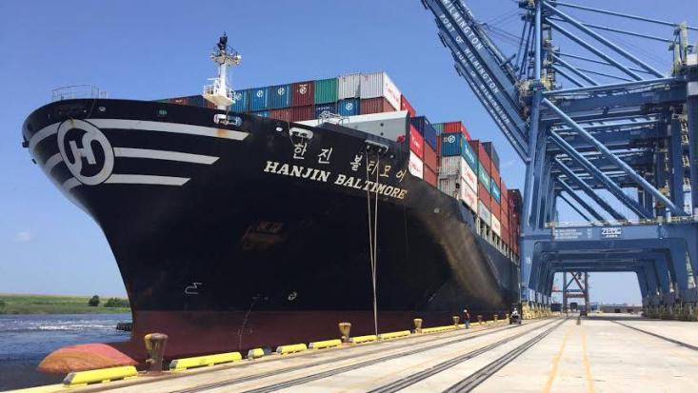
Carrier’s Responsibilities
Three Primary Responsibilities
Stow
Segregate
Communicate
§176.5 states “This subchapter (49 CFR) applies to all vessels, foreign or domestic, when in the navigable waters of the U.S.”
Notes:
On deck verses below hold stowage:

Slide 12
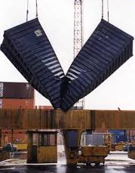
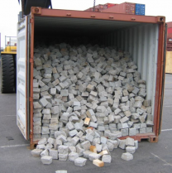
Communication
A vessel may not accept a hazardous material for transport unless they receive:
Shipping Papers w/ Shippers Declaration
Container Packing Certificate
Verified Gross Mass of container provided.
Notes:
New (actually not new requirement) SOLAS rules: July 2016. Long history of “estimating” weight.
The SOLAS (Safety of Life at Sea Convention) Amendment to make shippers responsible for verifying the gross mass of a packed container and its contents has sent reverberations around the industry with many saying they were not ready, or not even aware of the new requirements that came into force on 1 July this year. Many in the industry say this was an unnecessary step and will distort trade and at least add cost to the freight journey of a container at a time when certain players in the industry, notably ocean carriers, are facing something of a crisis in uncertain trade and financial markets. It is true that SOLAS which was mandated and then amended many times by the IMO (International Maritime Organisation) since its original inception following the “Titanic” sinking, has for many years included a mandatory requirement for shippers to declare the gross mass of their cargo correctly. So why has this new requirement to verify gross mass when that cargo is packed into a freight container come as such a shock? 60 years on, should we not know what the weight of the container and its cargo is? Is estimation of same such a bad thing? Evidence presented to IMO delegates showed that it can indeed be a significant problem and has led to many incidents of collapsing container stacks, damaged containers overturned vehicles and equipment and even whole vessels capsizing. The WSC (World Shipping Council) led calls at IMO for this new legislation following extensive research carried out by the MARIN Research Institute in the Netherlands. This research, titled “lashing@sea”, was carried out by various liner shipping companies and interested organizations over several years into the loss of containers overboard across the globe. Of its many findings and recommendations, the one that IMO decided to tackle first was the “mis-declaration of container weights”. Evidence from several serious marine casualties showed that there can be a large variance in what shippers declare the weight to be and the actual weight. shows the safety load cell indicator on a top-lifting container fork lift indicating a weight of 42 T. Such cells are generally calibrated to give a reading to +/- 5 % as they are designed to protect the equipment from being overloaded. So the actual mass being lifted may have been anything from 39.9 T to 44.1 T.
What is clear though is that the particular container was grossly overloaded with paving blocks (Figure 2) and in fact was only a standard 20-foot dry van (the basis for a teu) which probably had a maximum cargo carrying capacity in the region of 28 T. Imagine the consequences of stowing this container high up in a vessel’s stow; it is easy to imagine what could go wrong.
New SOLAS Legislation
This, then, is the essence of the new legislation. Shippers have a history of, if not wholeheartedly mis-declaring container weights, then certainly “estimating” them, in some cases because of the complexities of the contractual relationships and who is actually packing the container. However, the industry has said enough is enough, and it is clear that it is the industry and not governments as that is where initial calls came from and – the IMO would not make legislation for its own sake. That said, of course all government signatories to the SOLAS convention have accepted the new legislation; however, this is adding to uncertainty and confusion as very few of those governments have actually issued their own national legislation and/or guidelines on how the matter will be handled in that particular nation.
So if the industry called for this, why so much confusion and dismay? Much of this springs from uncertainty of where the physical act of weighing will take place and on what equipment.
How can the cargo and container be weighed?
We know the VGM must be obtained using one of two methods:
Method 1: Weigh the packed container in in its entirety; or
Method 2: Weigh all the cargo items, packaging, dunnage and lashing and securing materials and then add the tare weight of the container.
This was a “compromise” solution as many argued that the world was not quite ready for full implementation of Method 1 only.
Whichever method is used the equipment has to be “certified” and “calibrated” to the standards approved by the competent authority in the nation where the packing takes place. Sounds simple in practice? Well let’s consider the options: Method 1 necessarily implies weighing the whole packed container, but in almost all cases the container will be on the back of some kind of trailer or chassis. This suggests utilizing a weighbridge. Certification and calibration of weighbridges is generally well established, there are many in use for trade today and accuracy levels across a range of weights are well established. However, the question is where are these weighbridges? Are they well positioned along container logistics supply chain routes? Are there sufficient in number? Will they necessitate multiple journeys as the vehicle itself will need taring off to reach an accurate VGM unless a piece of lifting equipment is positioned at the weighbridge to lift the container off the vehicle? Some also say that “estimates” of vehicle weights and variables such as fuel, etc. throw the whole requirement for greater accuracy into doubt. What about two TEUs on one chassis, what about road trains? No doubt weighbridges will be an effective solution for many but the industry needs a range of solutions. During recent ICHCA and other events we have seen a range of new technologies emerge that provide weighing opportunities at other points in the supply chain. It has long been recognized that weighing as the container is lifted onto the vessel at the quayside is far too late in the process; this was recognised in the SOLAS amendment wording which states “VGM shall be communicated in sufficient time to enable effective stow planning”. So if weighing is to take place at the port, and many argued this was the best place, as all containers must pass through there, then some kind of weighing capability on the receiving equipment, be that a top lift, RTG, RMG, etc. seems a sensible option.
However, SOLAS stopped short of making it mandatory to weigh at the port, the safety argument being that the container should be weighed as close to its packing point as possible. i.e the shippers premises, warehouse etc. However SOLAS has made terminals jointly responsible with ocean carriers for not “loading” the container onto a ship without first having received, or themselves obtaining that VGM.
Solutions and certification
This is where one of the problems lies; many manufacturers have offered solutions but terminals were loath to buy and install until they were sure someone was going to pay them to receive financial return on their considerable investment. Terminals usually have contracts with ocean carriers (i.e the shipping lines), but the responsibility for obtaining VGM is that of the shipper who generally does not have any form of contractual relationship with terminals.To add to the complexity, certainly in the early days, terminals were also looking at buying systems that were not yet “certified and calibrated” to the competent authority approval and this was seen as a major stumbling block and one that manufacturers of new technology, such as twist lock sensors fitted to the port receiving equipment, had not paid much attention to in their efforts in concentrating on getting the technology right itself first. Fig 3. Twistlock sensor technology allows weighing of at least two containers simultaneously
Add to this the fact that nations were slow in issuing guidelines – the UK was the first to do so – many still have not, and it can be seen why there had been very little uptake. Manufacturers confirm there has been a recent surge in orders and this situation will continue for some time as industry adjusts. The issue of certification has been helped enormously by the involvement of the OIML. Sadly, the OIML was not consulted by IMO or any of the national governments or industry bodies in the build-up to the adoption of this legislation. It was only by Ian Dunmill attending ICHCA’s conference on the subject in September 2015 that the organisation became aware, formally, of the requirement and we have been engaged with each other since. The OIML’s extensive network of Member States and Corresponding members across the globe is now assisting with manufacturers obtaining approval for their systems using established OIML standards and methodology and this will enable the industry to meet its obligations. To conclude, many manufacturers are now providing solutions for the container logistics supply industry to help them meet their new requirement to obtain VGM. Weighbridges and similar technology such as platform scales (for Method 2) and conveyor weighing systems exist and are well developed but will only provide some of the capability. New technological solutions are being developed that a have significant added value, for example dynamic or “weigh in motion” weighbridges can detect differences between vehicle axle weights. Some sensitive weighbridges are being developed to detect container weight distribution “eccentricity”. Container spreader twist lock sensors can also detect such eccentricity and furthermore can detect snag loads, i.e. lifting the container with the vehicle still attached.
And what will happen next?
A stated Method 2 was an industry and IMO compromise and there are fears that accuracy levels will not improve significantly as shippers may continue to just “estimate” gross mass. If that is the case, then in a few years, if containers continue to be lost overboard then IMO may call for removal of this option and leave just the “gold” standard of having every packed container physically weighed. What about that “eccentricity” issue? The new Code of Practice for Packing Cargo Transport Units issued by the IMO, ILO and UNECE certainly addresses this along with other packing and securing issues, but not mandatorily. Some argue that knowing the accurate weight is not enough, particularly the rail operators, and this could be the next logical step. Whatever happens, the industry will now move forward , albeit with perhaps a bumpy few months as the “New Operational Reality” (as the WSC calls it) settles in .However the industry must work in close liaison with the OIML in order to ensure that the gross mass of a packed container can be calculated as accurately as possible to ensure the safety of loading and subsequent transport.

Slide 13
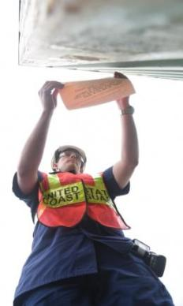
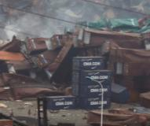
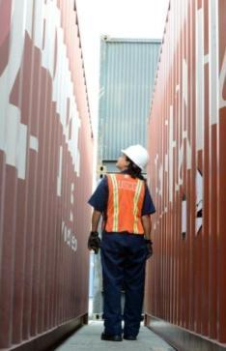
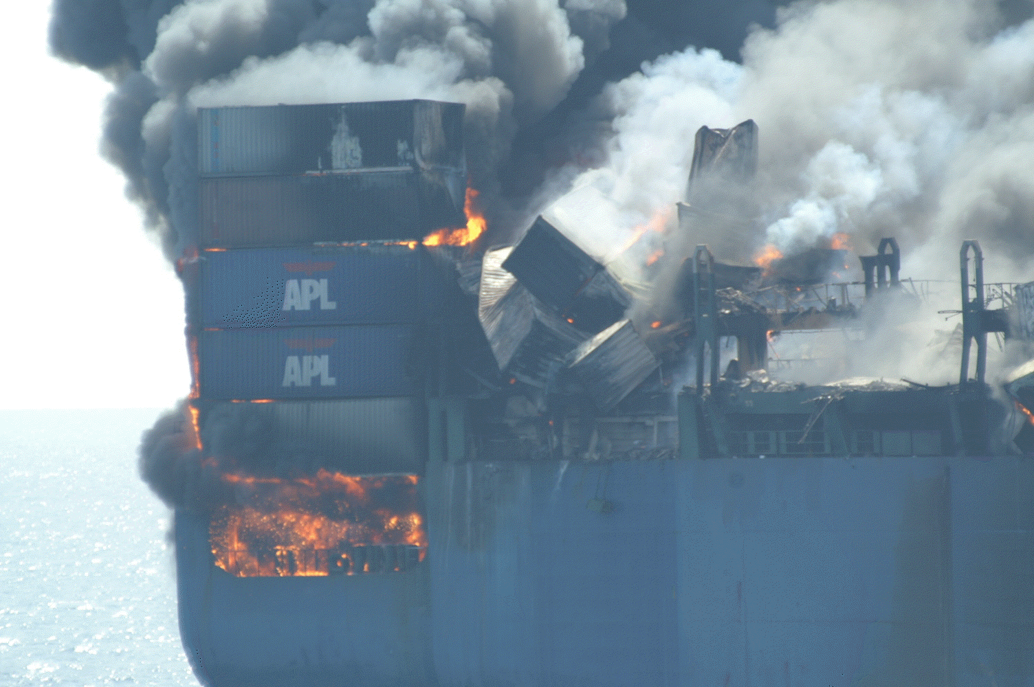
Issues
Bridge clearances
Ample range of view from pilothouse
Educating towing community on packaging, shipping papers & containers

Slide 14
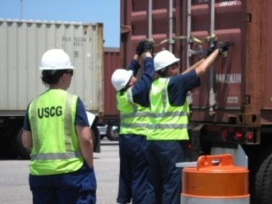
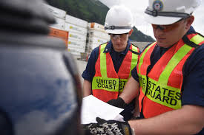
Issues Cont….
Building container yards
Securing yards
Arranging for transloads
Responding to leaks
Human trafficking
Illegal cargo

